Slide 1
The main lesson
Frequent commits allowed experimentation without fear of breaking the project.

Slide 2

The first two stages of development

Slide 3
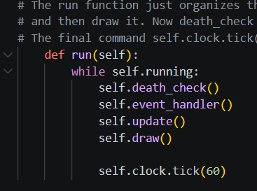
At its basic level, A game is a loop. While running: events update render display
Initialize pygame.init()
Screen = pygame.display.set_mode(800,600)
Render
screen.fill()
object.draw()
pygame.display.flip()
Timing
clock.tick()

Slide 4
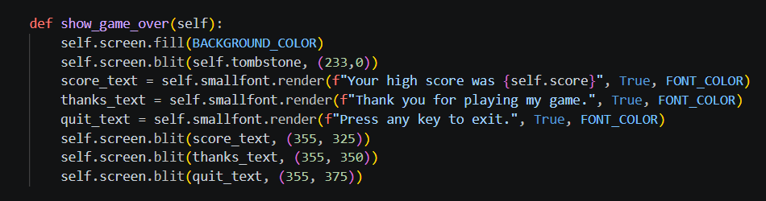
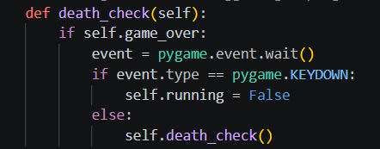
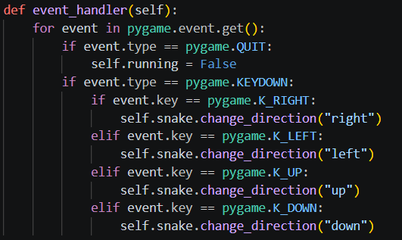
Feature Development
Code ->
Empty Window ->
Single Pixel ->
Moving Pixel ->
Grid movement ->
Walls ->
Fruit ->
Collision ->
High Score ->
Game Over ->
Music
Each feature builds on top of the features before it.

Slide 5
Organizing Complexity using OOP
GameObject
|
--------------------------------------------------------------------------------------------------------------------------
| | |
Fruit Wall Snake Segment | Snake
GameObject : Position, size, color, draw()
Snake:
Movement, Collision, Body Management Fruit, wall, and SnakeSegment all inherit from GameObject
Snake uses composition to manage a collection of SnakeSegments.

